Slide 1

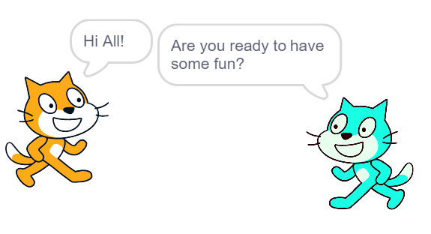
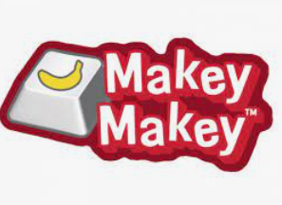
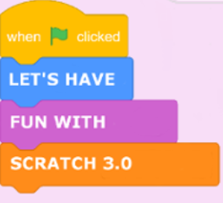
Scratch
with Makey Makey
Presenter: Ronelle Allen
Intervention teacher - Coombabah State School
Acknowledgement: Thanks to Derek Ranclaud for
letting me use some of your PowerPoint for this
Presentation today.

Slide 2
What is Scratch 3.0?
.
Scratch 3 is available as an online chrome app or an offline app, otherwise known as the Scratch 3.0 desktop offline editor.
Scratch is a block- based visual programming language. It makes building programs easy. Scratch 3.0 allows kids, to program their own creations by sequencing coding blocks together. It is a fun way to have students build scripts that control the movement and appearance of characters. It can be used to make interactive stories, games, puzzles, artwork, music, and more!
Notes:
This method of programming (building code with blocks) is referred to as “drag and drop programming”. The Scratch cat is the mascot of Scratch and the default sprite (character) when opening a new Scratch Projects.

Slide 3
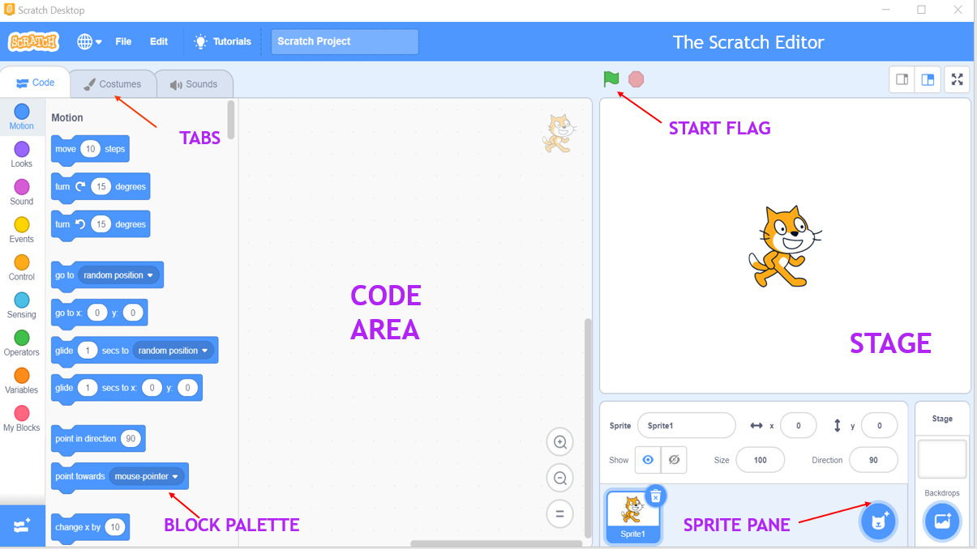
Scratch 3 Interface
.
ADD AN EXTENSION
Notes:
This method of programming (building code with blocks) is referred to as “drag and drop programming”. The Scratch cat is the mascot of Scratch and the default sprite (character) when opening a new Scratch Projects.

Slide 4
This Session:
What is a Makey Makey?
How does it fit into the Digital Technologies and Design Technologies curriculum?
What is a circuit?
Where do I start?
How does it work?
Connecting the Makey Makey
How can I use Makey Makey across the curriculum?
Project ideas
Cleaning Makey Makey

Slide 5
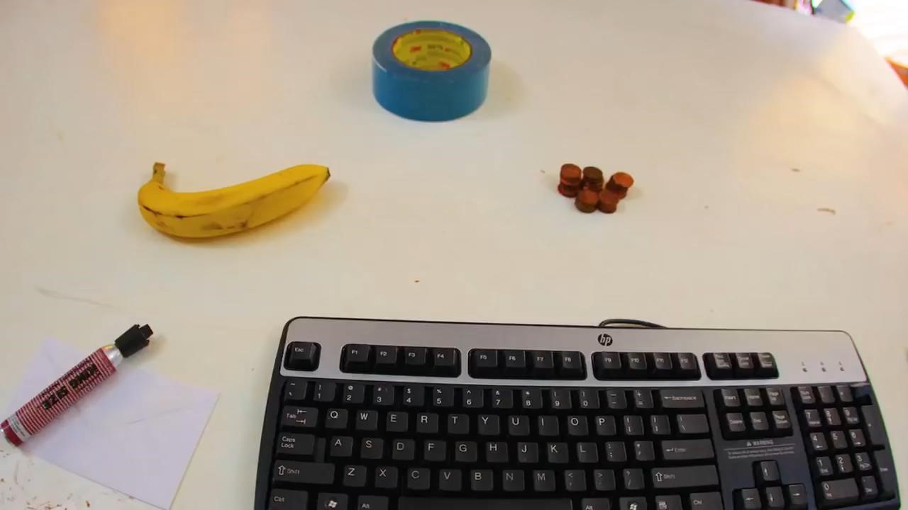
Intro to Makey Makey
Source: https://www.youtube.com/watch?v=rfQqh7iCcOU

Slide 6
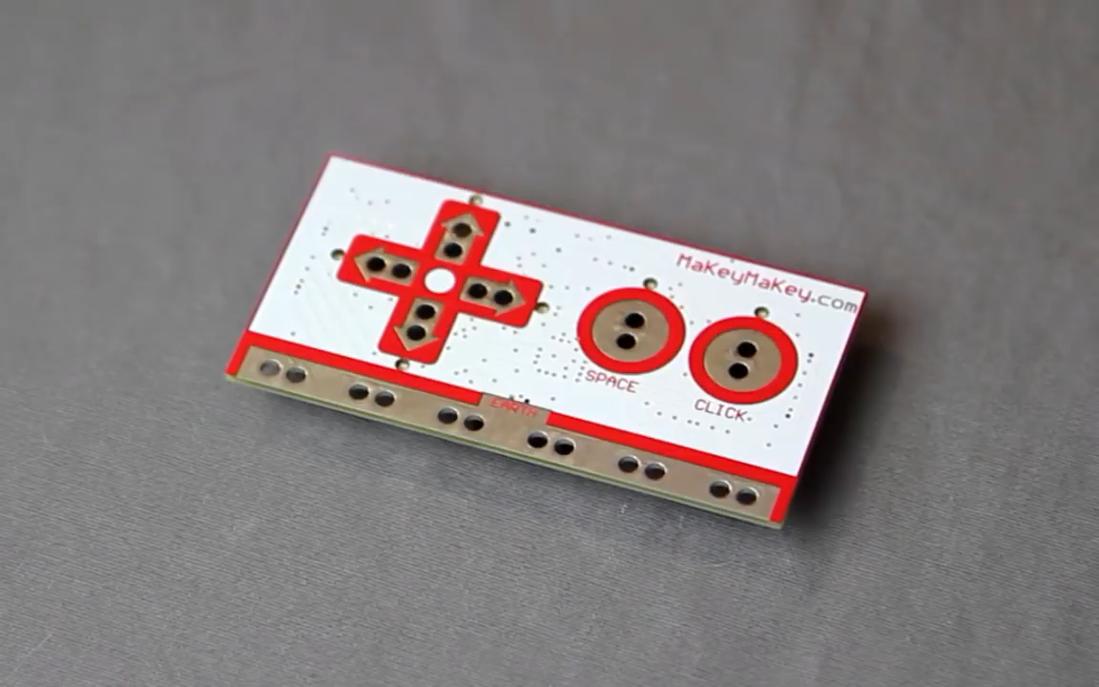
What is Makey Makey?
Notes:
Play until 1.11 – extra if needed

Slide 7
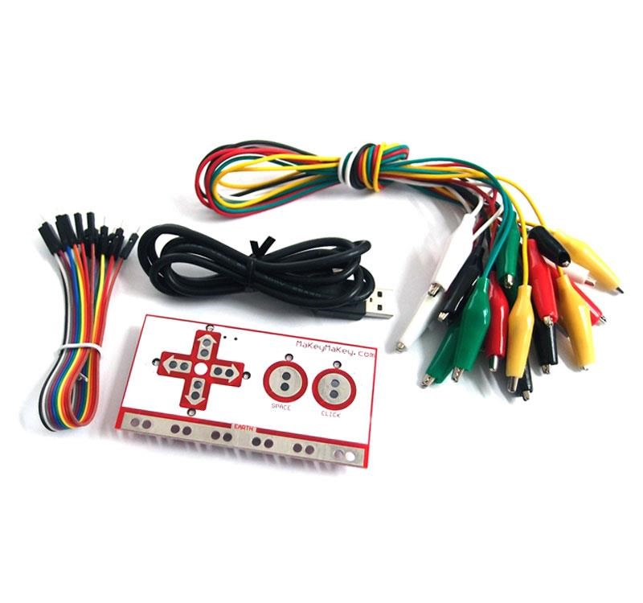
What is Makey Makey?
A makey makey is a circuit board that allows users to connect everyday objects to computer programs using alligator clips and a USB cable. The board uses closed loop electrical signals to send the computer either a keyboard stroke or mouse click signal.

Slide 8
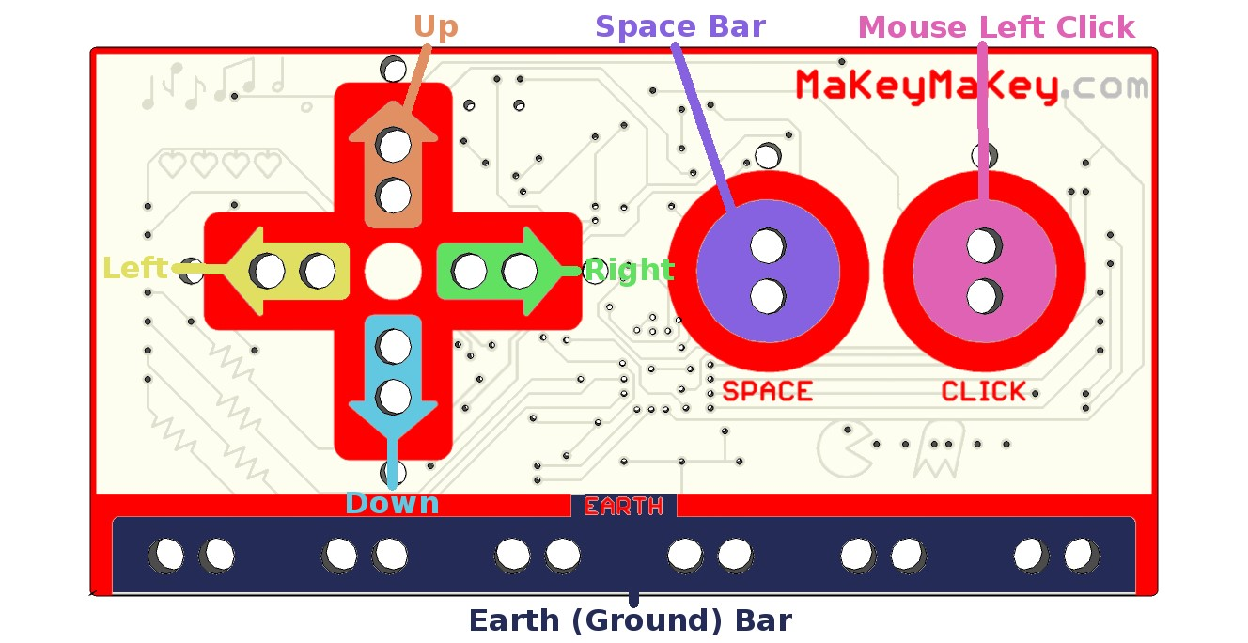
Makey Makey Front:

Slide 9
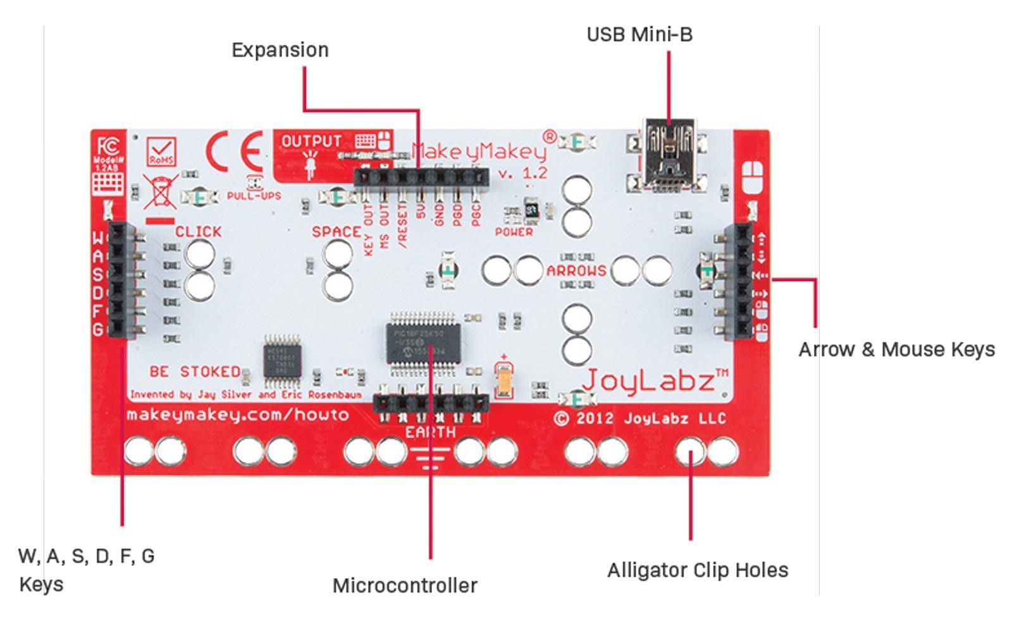
Makey Makey Back:

Slide 10

Digital technologies Curriculum
Notes:
These are also the Design and Technologies Processes and Production skills. Makey Makey could be used in a Design and Technologies unit of work.

Slide 11
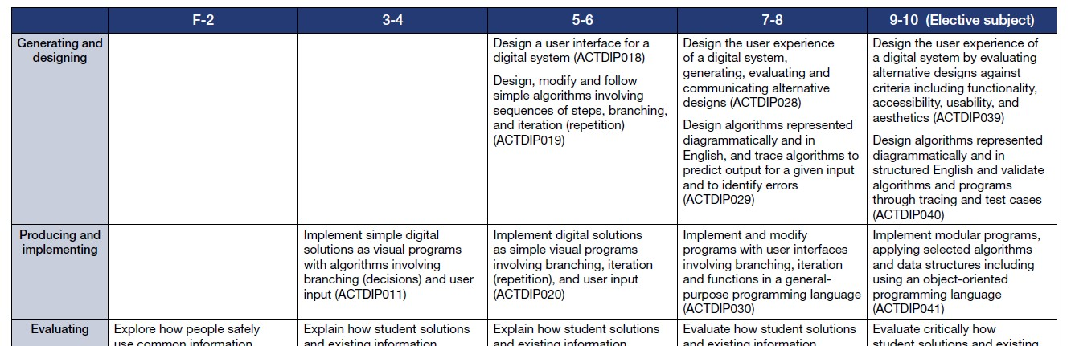
Digital Technologies Curriculum
Create digital solution
Sequence of content:

Slide 12
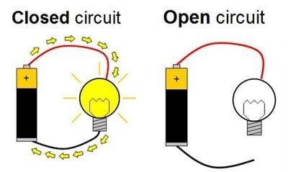
What is a Circuit?
Notes:
An electric circuit is an unbroken path along which an electric current exists and/or is able to flow. A simple electrical circuit consists of a power source, two conducting wires (one end of each being attached to each terminal of the cell (battery) and a small lamp to which the free ends of the wires leading from the cell are attached. Makey Makey could be used to help explain circuits. In Year 6 Science (C2C Unit 2 – Energy and Electricity) Students design and construct electrical circuits. They investigate electrical circuits as a means of transferring & transforming electricity. Year 6 C2C Unit 2 Design and Technology _ Students investigate how electrical energy can control movement, sound or light in a designed product or system. They design a solution to an environment’s security need and make a prototype electrical device that is part of the solution.

Slide 13
Where do I start?
Introduce Makey Makey and discuss how it works.
Use playdough to make a basic game or experience with music.
Makey Makey and conductivity
Test what materials are conductive of electricity

Slide 15
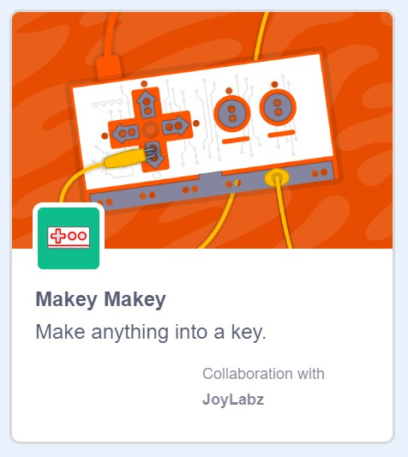
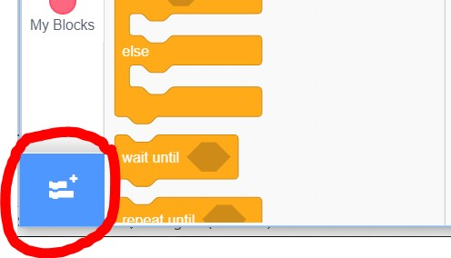
Add an extension

Slide 16
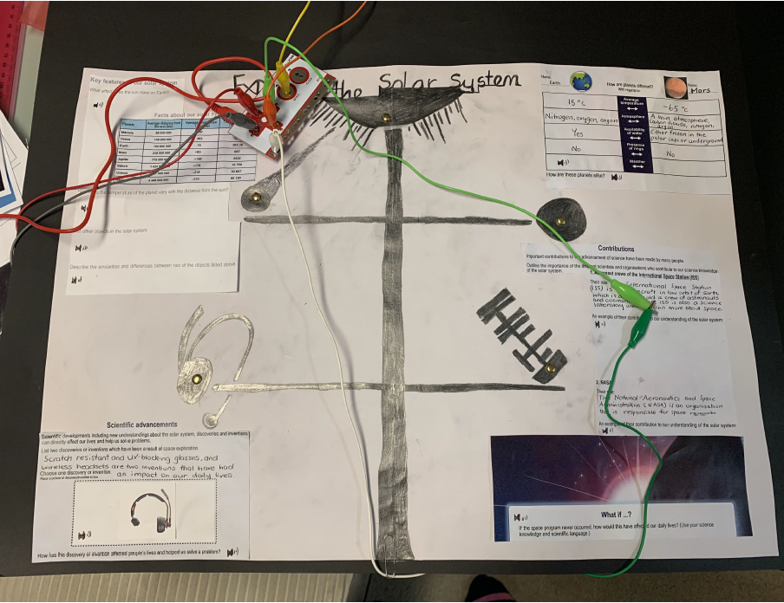
An interactive poster using Makey Makey:
Year 5 C2C Science Unit 2 – Our place in the solar system
Notes:
TPT resource Make some Makey Makey Artwork.

Slide 17
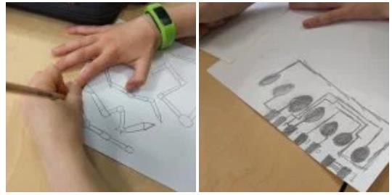
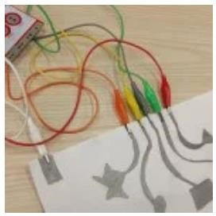
Year 3&4 Paper Circuits-Interactive Posters
Year 3 C2C Science Unit 2 – Investigating the sun, Earth & us. (Use an interactive poster for the assessment)
Year 4 C2C Science Unit 2 – Ready, Set, Go – Part A – Create an interactive poster for the Life cycle of an endangered species
Notes:
TPT resource Make some Makey Makey Artwork.

Slide 18
Makey Makey Operation game – Exploring circuits
Year 6 C2C Science Unit 2 – Energy and Electricity
Revision using Scratch Interface

Slide 19
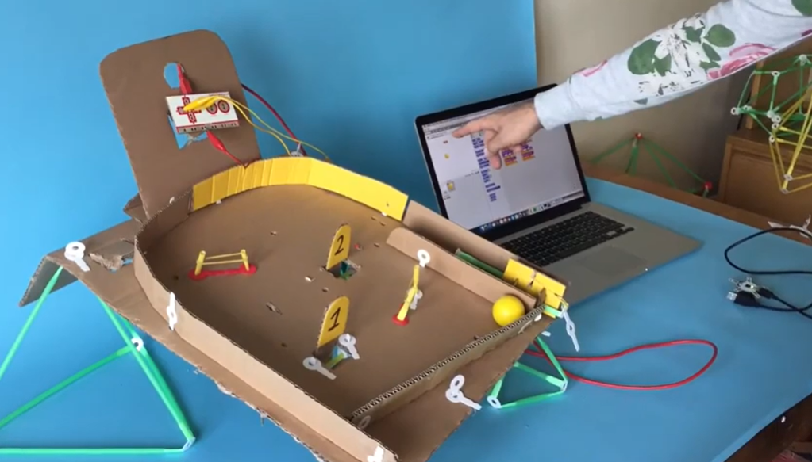
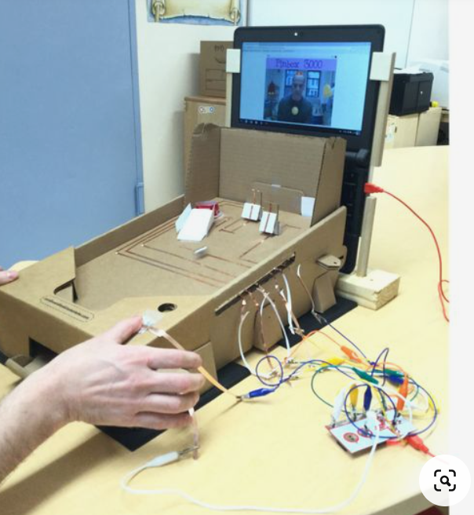
Makey Makey – Pin ball machine
Year 4 Design & Technologies – Investigate how forces & the properties of materials affect the behaviour of a product system. Students design and make a Pin ball machine for this assessment.

Slide 20
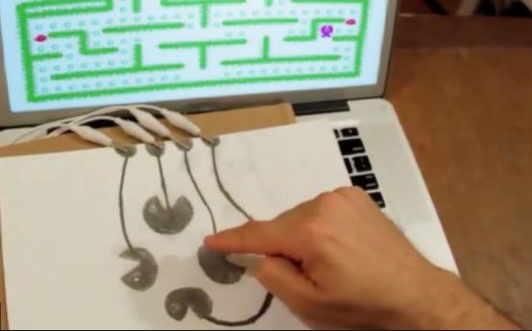
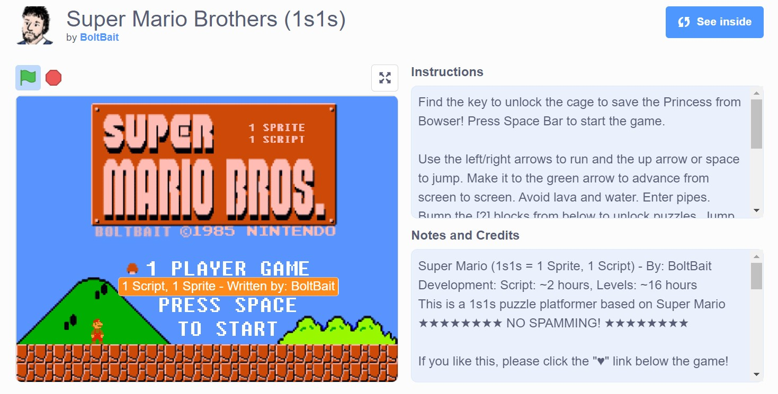
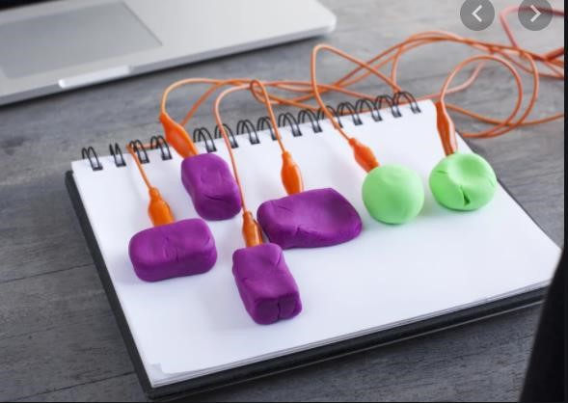
Super Mario Brothers
Makey Makey – game controller
https://scratch.mit.edu/projects/2176968/

Slide 21
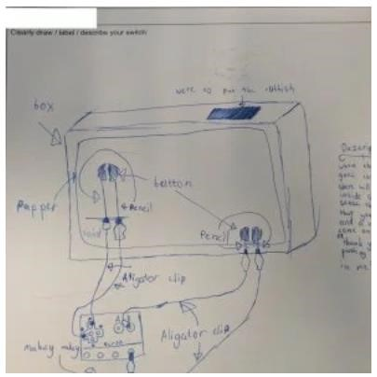
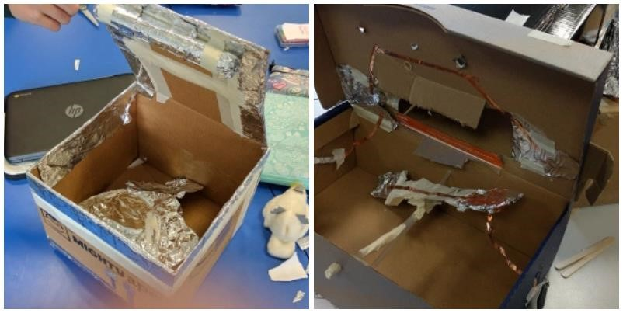
Year 5/6 project:
Electronic Bin Project

Slide 22
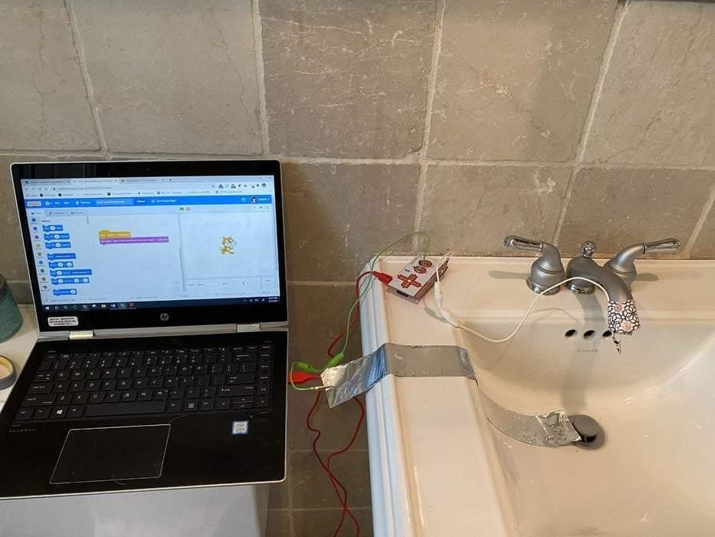
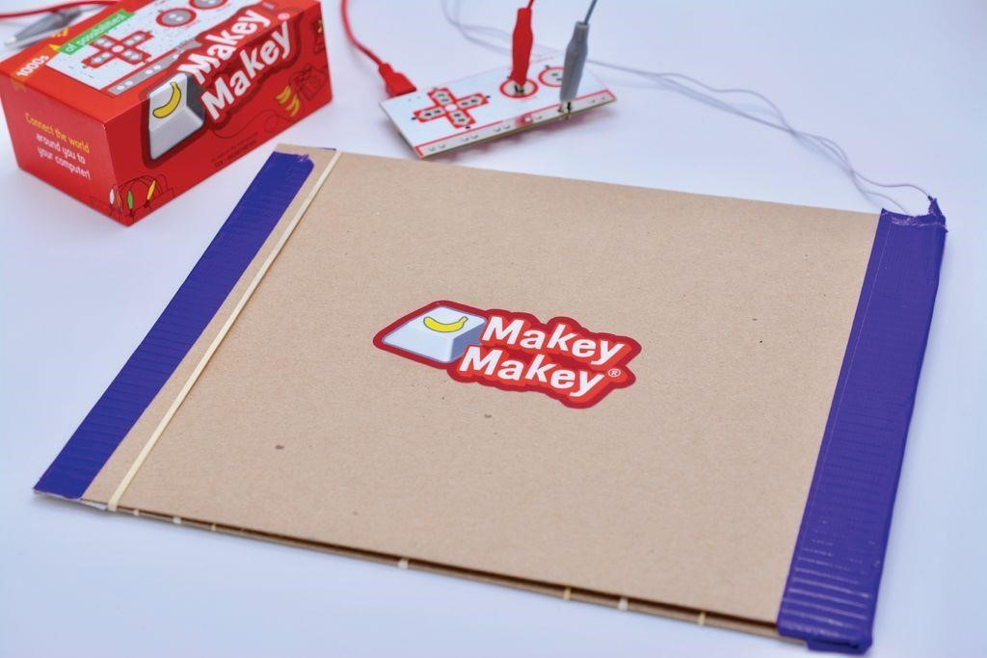
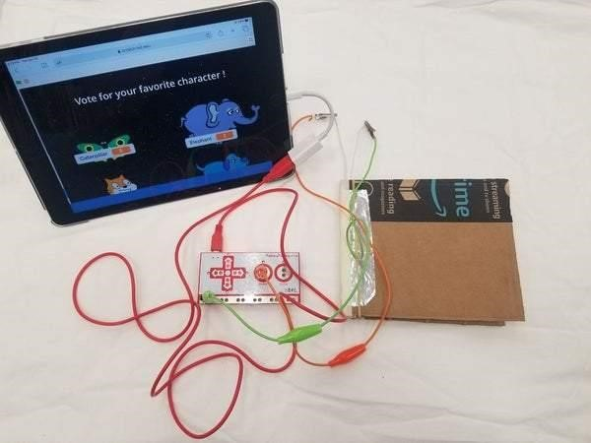
Covid Projects
Hand washing station
Foot stomping switch (Y6 – Design & technologies C2C unit 2 – Designing an electrical device
Vote with your feet

Slide 23
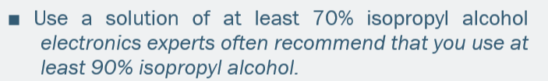
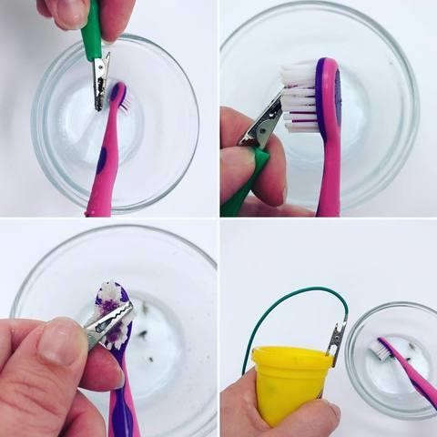
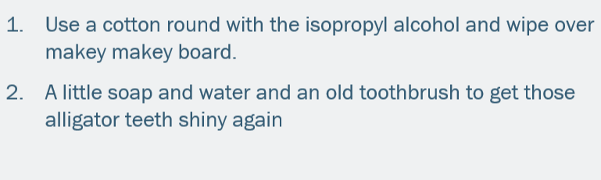
Cleaning Makey Makey
Cleaning Video - https://youtu.be/UZpdsCZgg1o

